Slide 1
Pastoral Assistant Learning Course
Session 6 - Reflecting on Experience
Pontypridd Ministry Area, March 2024

Slide 2
Gathering
God our Father, Lord of all the world, through your Son you have called us into the fellowship of your universal Church:
hear our prayer for your faithful people that in their vocation and ministry each may be an instrument of your love, and give to your servants the needful gifts of grace; through our Lord and Saviour Jesus Christ, who is alive and reigns in the unity of the Holy Spirit, one God for ever and ever.
Amen.
Notes:
As we begin, let’s spend a few moments in silence, offering any worries or concerns from our daily lives to God, and acknowledging God’s presence among us. (You may wish to light a candle, if you are in a space where that is possible.)

Slide 3
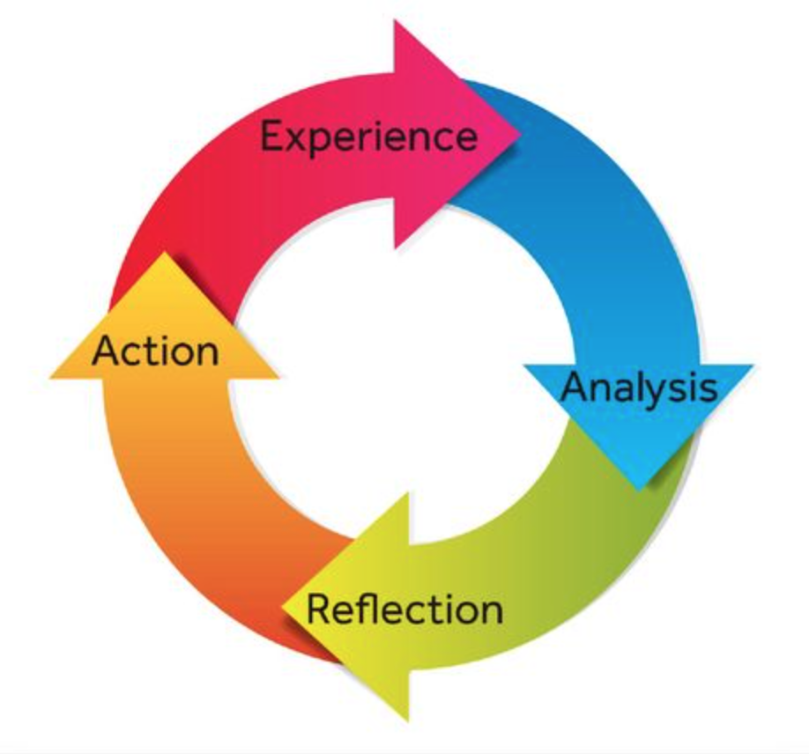
The Pastoral Cycle
Notes:
In these first few slides, the key quotes from the session are brought up to jog the memories of participants and get the conversation flowing. Ask people what they think of them. And ask the questions from the ‘general reflection section.’
For this session, reflect on the pastoral cycle, and its usefulness in reflecting upon pastoral visiting experience.

Slide 4
Reflecting Together
Practicing an Examen
Step 1: Relax and Find Stillness
Step 2: Asking God to Bring Moments Back
Step 3: Being Aware of God’s Love and Our Shortcomings
Step 4: Giving Thanks and Praying for Wisdom
Notes:
As part of our reflections today, we are going to practice doing an examen together.
There are four steps that we will work through, and I will help guide you through each one, but we will spend quite a bit of time in silence, listening to God and to ourselves and the experiences that come to mind.

Slide 5
Reflecting Together
How did it feel to be listened to and affirmed?
What makes for good listening?
What makes for bad listening?

Slide 6
Exploring Together
What are the most important practical factors that aid in good listening?
What do you find most difficult in listening well?

Slide 7
Exploring Together
Why is confidentiality important, and what are the limits of confidentiality in pastoral care?
How, why and with whom is pastoral information shared in your Ministry Team?

Slide 8
Responding and Concluding
What is one thing you’ve learned this session?
What do we need to do in preparation for our next session?
Notes:
Look at the Ministry book, pages 25 to 28. Take time with the reflection questions.

Slide 9
Responding and Concluding
May the grace of our Lord, Jesus Christ,
And the love of God,
And the fellowship of the Holy Spirit,
Be upon us and remain with us always. Amen.
Go in peace to love and serve the Lord.
In the name of Christ. Amen.

