Slide 1
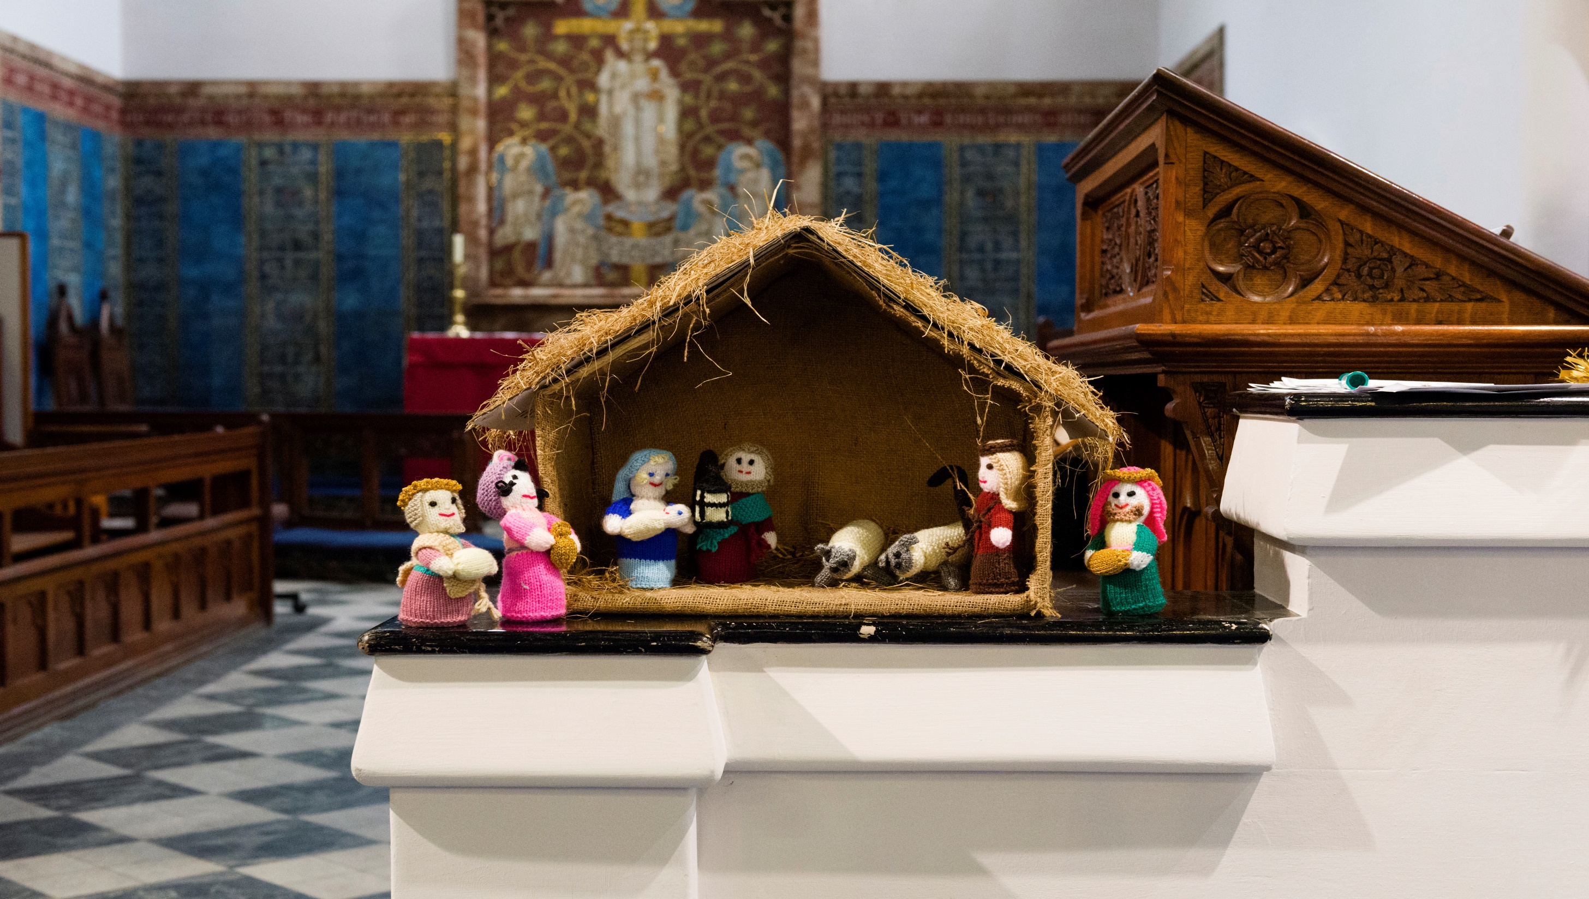
Framing memories: Christmas
with Canon Sandra Millar Head of Welcome and Life Events

Slide 2
What we will cover:
Where we are now
Welcome and purpose
Frameworks
What we can do
Communication
Questions:
please enter any time during the webinar
Notes:
I will welcome and introduce myself and the topic, before going through the things we are going to cover.

Slide 3
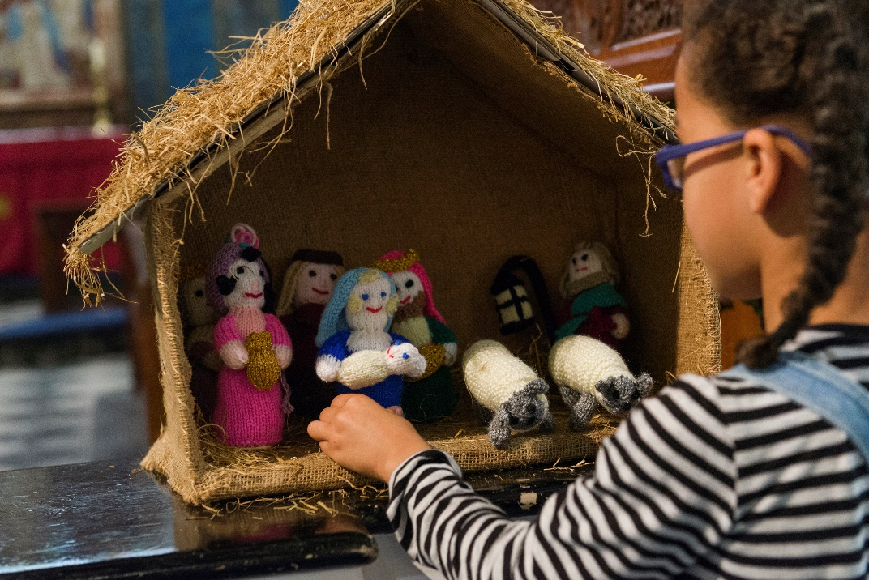
Core intentions:
Reassurance
Confidence
Affirmation
Art of the possible
Becoming “memory makers”
Notes:
I will welcome and introduce myself and the topic, before going through the things we are going to cover.

Slide 4
Everyone’s ministry
Our vocation
Our experience
Our training
Our heritage
Our Gospel
please enter questions at any time
during the webinar

Slide 5
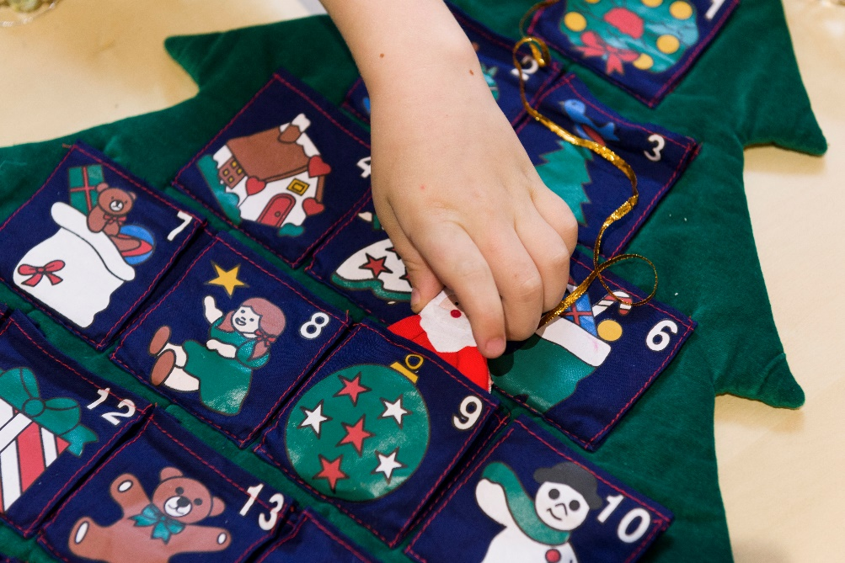
Christmas is not cancelled…
Context
Welcome
Delight
Safety
Communication
Expectations
Different is not worse
Notes:
Talking about the stage we have now reached when people are coming back after the lockdown – how we need at attitude of confident, joyful welcome. Reminder that every context is about safety – not just church. What expectations do we have, and what do those who come to us have? And what will be same for people – excitement, celebration, marking a life change

Slide 6
So why does it matter?
Touch point for thousands
Gives meaning
Sharing virtues
Brings hope
The heart of the Gospel
Notes:
Talking about the stage we have now reached when people are coming back after the lockdown – how we need at attitude of confident, joyful welcome. Reminder that every context is about safety – not just church. What expectations do we have, and what do those who come to us have? And what will be same for people – excitement, celebration, marking a life change

Slide 7
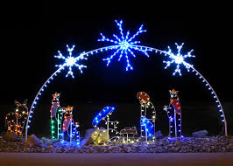
Encounters on faith journeys
Wherever they happen: digital, physical
Whenever they happen: new to faith, new to place
Whatever they are for: events or worship
‘Put yourself in other’s shoes’
Notice good and bad practice

Slide 8
Who?
Regular regulars
Irregular regulars
Partner organisations
Care homes
Bereaved people
New family groups
Those alone for Christmas

Slide 9
Making friends
Anticipation and excitement | Trust and delight
Fear and anxiety | Reassurance and confidence
Warmth/relational
Process/transactional
Notes:
Before we go further, talk about this grid, which helps us frame the journey people are on. We want them to journey toward ‘trust and delight’

Slide 10
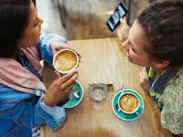
Boxing day and beyond:
Where will you see each other again?
Who will follow through?
Church?
Practical help?
On-line
Mid-week
For a coffee?

Slide 11
Four actions:
See - noticing people
Smile – reflect the kindness of God
Say hello – make connections
Invite on to friendship
with God and God’s people

Slide 12
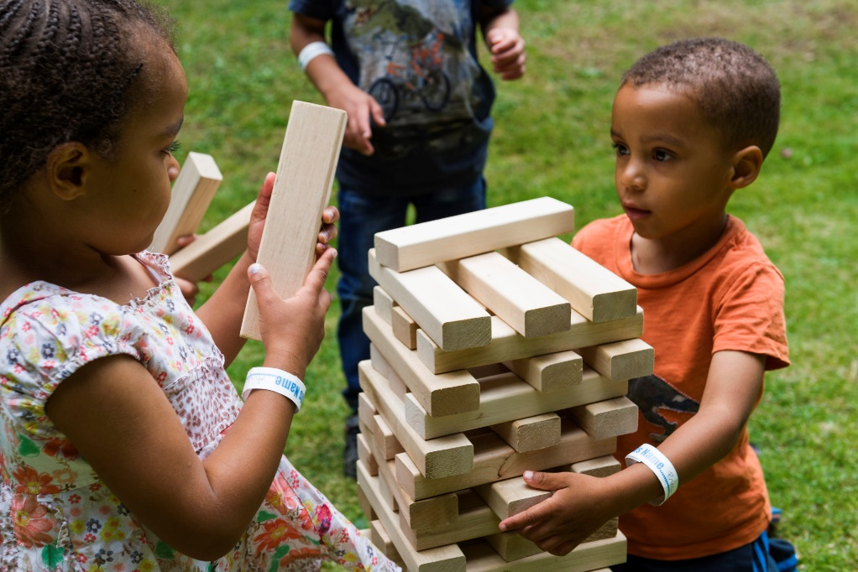
Four Is
Information – people know what is happening
Invitation - specific and targeted
Interest - conversations and friendship
Involvement – helping out

Slide 13
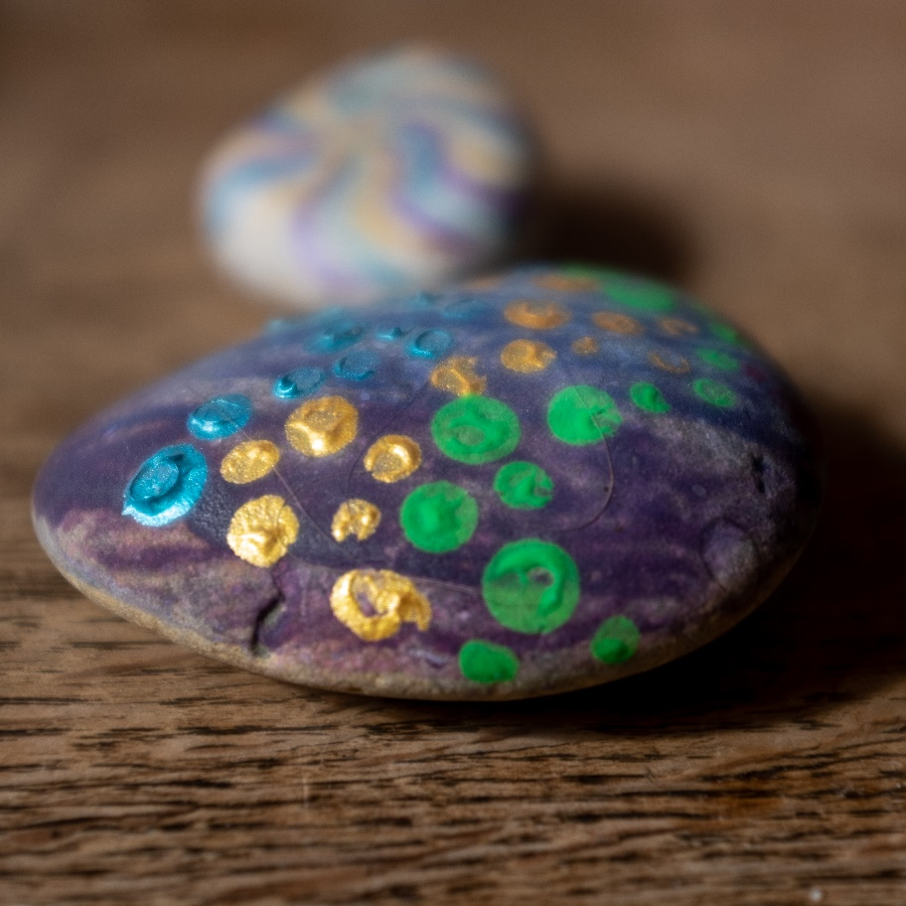
What: focus
‘Services’ – thinking differently
Physical – indoors, outdoors
Digital opportunities
Domestic spaces
Do two things well

Slide 14
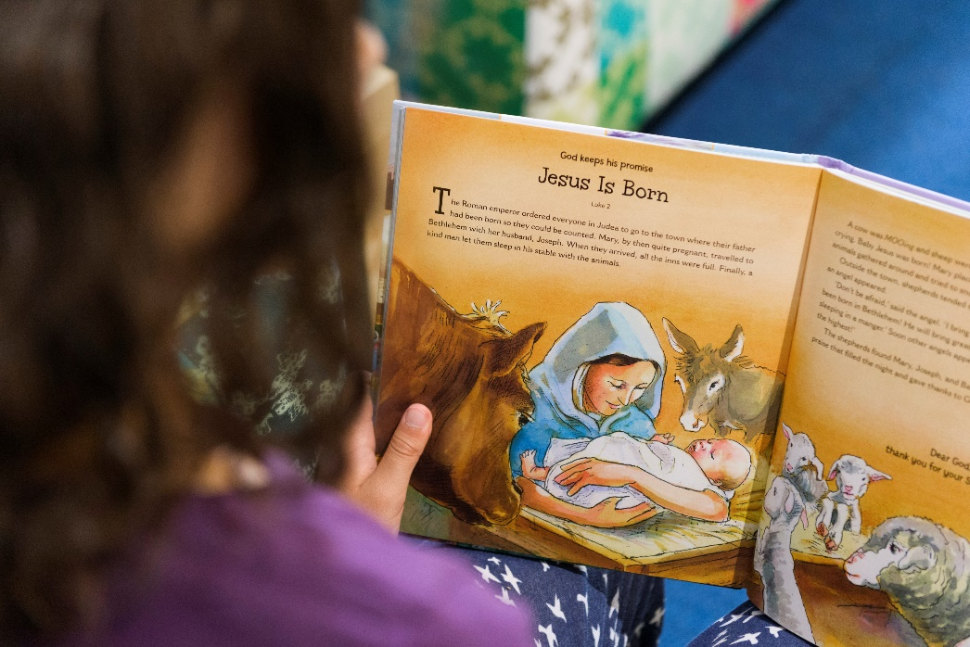
Spaces: digital and domestic
Prayer in the home
Activity in the home
Shared moments
Post

Slide 15
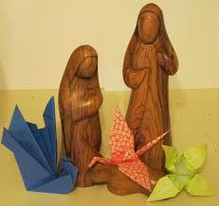
Spaces
Outdoors
prayer spaces
Trails and hunts
Windows and walks
Posada
To the people..

Slide 16
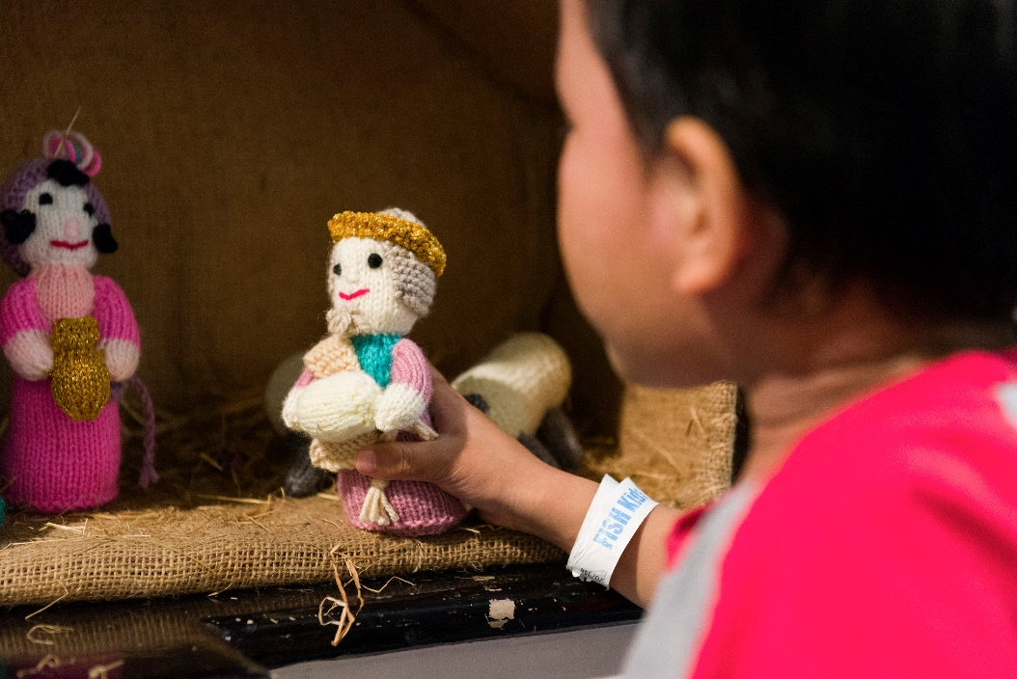
Spaces
Indoors
Moments of joy
Moments of comfort
Familiar services
Audiences

Slide 17
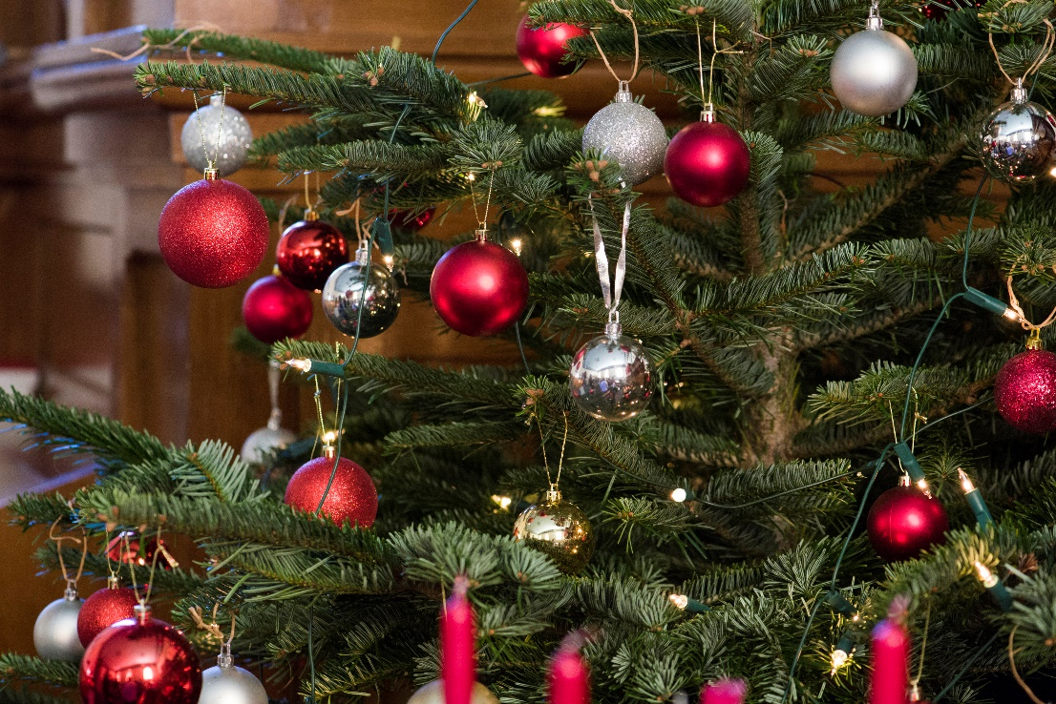
Spaces: communal
Local partnerships
Shared moments
Creativity
Participation
Joy – excitement
Comfort - realism
Cultural awareness

Slide 18
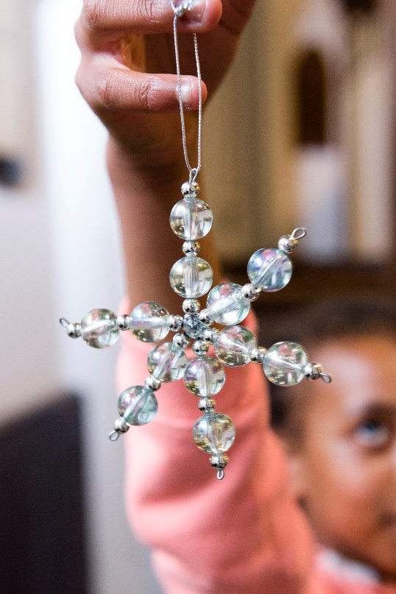
Moments and memories
Trees and lights
Symbolic actions
Cribs and the real story
Silence and stillness
Traditions – music, words

Slide 19
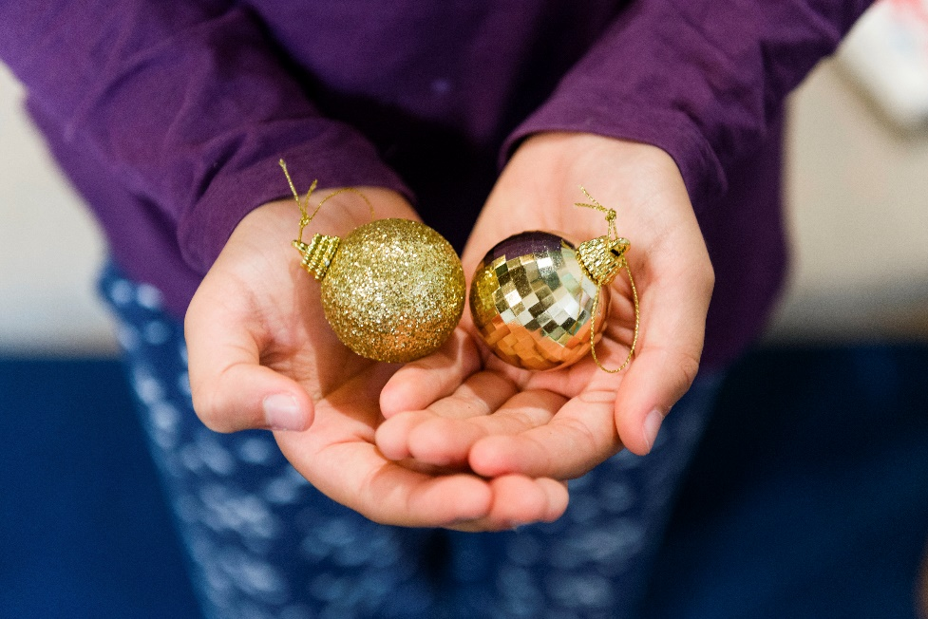
Communication:
Where?
How?
What?
Information
Invitation
Continued - relationship

Slide 20
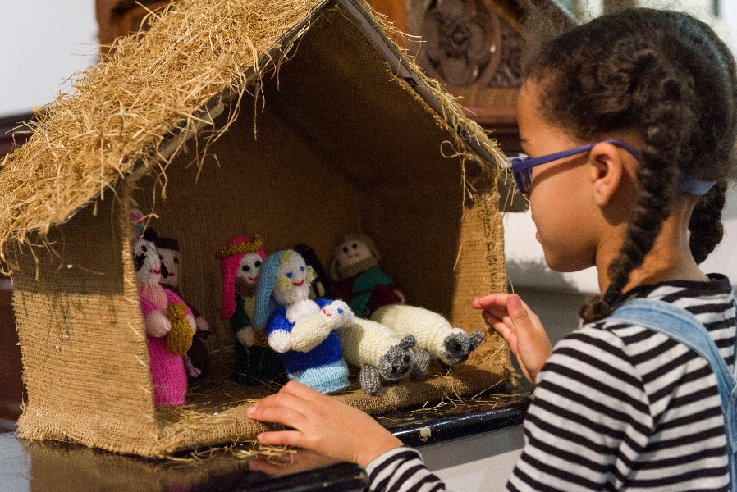
Core intentions:
Confidence – we have a message
Affirmation – you are doing a great job
Reassurance – you can do this
Art of the possible – gathered will be the bonus
Becoming “memory makers” - it’s not about disappointment but about delight
Notes:
I will welcome and introduce myself and the topic, before going through the things we are going to cover.

Slide 21
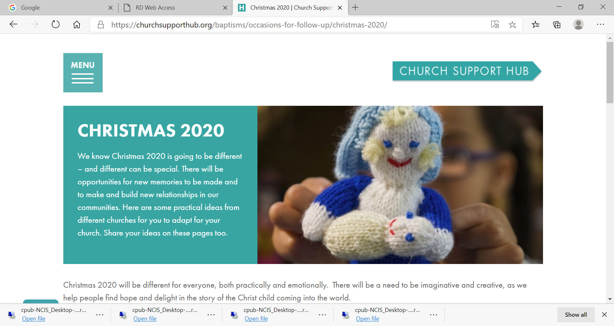
Churchsupporthub:
Churchsupporthub/christmas2020
Information
Insights
Ideas
Free Downloads
Notes:
The print hub is where to buy all the weddings materials as well as other resources

